Slide 1
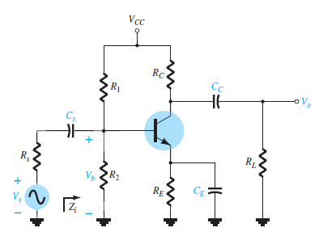
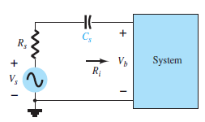
University of Diyala Engineering College
Department of Communications Engineering
Electronics II : 3^{ed} Year - 2015/2016 By: Hussein Ahmed Mahmood
IMPACT OF R_{S} ON THE BJT LOW-FREQUENCY RESPONSE
In this section we will investigate the impact of the source resistance on the various cutoff frequencies. In Fig. 5.
Fig. 5
Determining the effect of R_{S} on the low- frequency response of a BJT amplifier.
Fig. 6
Determining the effect of C_{S} on the low- frequency response.
C_{S} The equivalent circuit at the input is now as shown in Fig. 6, with Ri continuing to be equal to R₁ ||R₂|| βr_{e} . Doing so would result in the following Equation for the cutoff frequency:
so that
And

Slide 2
University of Diyala Engineering College
Department of Communications Engineering
Electronics II : 3^{ed} Year - 2015/2016 By: Hussein Ahmed Mahmood
Cc For the coupling capacitor Cc, we find that the derivation of the equation for the cutoff frequency remains the same. That is,
C_{E} For the same capacitor, we find that R_{S} will affect the resistance level substituted into the cutoff equation so that,
with

Slide 3
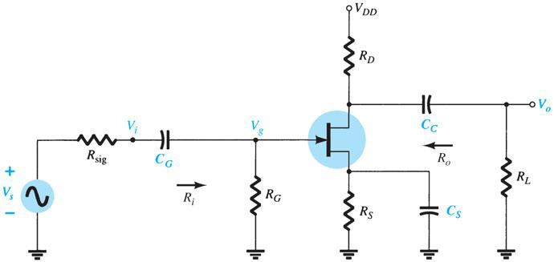
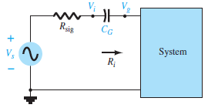
University of Diyala Engineering College
Department of Communications Engineering
Electronics II : 3^{ed} Year - 2015/2016 By: Hussein Ahmed Mahmood
LOW-FREQUENCY RESPONSE-FET AMPLIFIER
The analysis of the FET amplifier in the low-frequency region will be quite similar to that of the BJT amplifier. There are again three capacitors of primary concern as appearing in the network of Fig.7: C_{G}, C_{C}, and C_{S}.
Fig.7
Capacitive elements that affect the low-frequency response of a JFET amplifier.
C_{G} For the coupling capacitor between the source and the active device, the ac equivalent network is as shown in Fig.8. The cutoff frequency determined by C_{G} is:
Fig.8
Determining the effect of C_{G} on the
low-frequency response

Slide 4
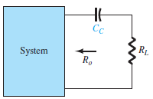
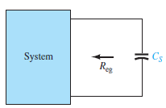
University of Diyala Engineering College
Department of Communications Engineering
Electronics II : 3^{ed} Year - 2015/2016 By: Hussein Ahmed Mahmood
Cc For the coupling capacitor between the active device and the load the network of Fig. 9. The resulting cutoff frequency is:
Fig.9
Determining the effect of C_{C} on the low-
frequency response.
C_{S} For the source capacitor C_{S}, the resistance level of importance is defined by Fig. 10.The cutoff frequency is defined by:
Fig.10
Determining the effect of on low-frequency
response.
For Fig.7, the resulting value of is
which for r_{d} = ∞ Ω, becomes
The midband gain of the system is determined by:

